Slide 1
Biomolecules: Carbohydrates and Lipids
BIO 101
Adu, Oluwatosin B.
C19-

Slide 2
Biomolecules: Molecules of life
Molecules form the structures of cells and carry out cellular functions. Chemical bonds within and between biological molecules are important to their structure.
Four groups of large molecules — carbohydrates, lipids, proteins, and nucleic acids — are the most important molecules to cells.
Carbohydrates provide energy and structure to cells.
Lipids form membranes, send signals, and store energy.
Proteins are the main worker molecules of cells, providing structure and doing lots of different functions.
The most famous molecule of life — DNA — is a nucleic acid. They encode the blueprints for life, and copies of this code are passed to future generations.

Slide 3
Carbohydrates
Carbohydrates are polyhydroxy aldehydes or ketones, or substances that yield such compounds on hydrolysis.
Many, but not all, carbohydrates have the empirical formula (CH₂O)_{n}; some also contain nitrogen, phosphorus, or sulfur.
There are three major size classes of carbohydrates: monosaccharides, oligosaccharides, and polysaccharides (the word “saccharide” is derived from the Greek sakcharon, meaning “sugar”).

Slide 4
Functions of carbohydrates
Carbohydrates are most famous for their role in providing energy to cells, but they perform many other important functions for cells as well:
✓ Carbohydrates are an important energy source for cells. The monosaccharide glucose is a rapidly used energy source for almost all cells on planet Earth. Plants, algae, and bacteria store energy in starch, and animals and bacteria store energy in glycogen.
✓ Carbohydrates are important structural molecules for cells. Polysaccharides are the major components of the cell walls of plants, algae, fungi, and bacteria. E.g., cellulose, chitin, and peptidoglycan.
✓ Carbohydrates are important markers of cellular identity. E.g., The surfaces of cells are marked with glycoproteins,. This gives different cells their identity.
✓ Carbohydrates are important extracellular molecules. Polysaccharides are a major component of the sticky matrix that surrounds cells. They help bacteria stick to surfaces and are also important in the attachment of animal cells to each other.

Slide 5
Monosaccharides
Monosaccharides are colorless, crystalline solids that are freely soluble in water but insoluble in nonpolar solvents. Most have a sweet taste.
The backbones of common monosaccharides are unbranched carbon chains in which all the carbon atoms are linked by single bonds.
One of the carbon atoms is double-bonded to an oxygen atom to form a carbonyl group; each of the other carbon atoms has a hydroxyl group.
If the carbonyl group is at an end of the carbon chain (that is, in an aldehyde group), the monosaccharide is an aldose; if the carbonyl group is at any other position (in a ketone group), the monosaccharide is a ketose.
The simplest monosaccharides are the two three-carbon trioses: glyceraldehyde, an aldotriose, and dihydroxyacetone, a ketotriose.

Slide 6
Monosaccharides with four, five, six, and seven carbon atoms in their backbones are called, respectively, tetroses, pentoses, hexoses, and heptoses.
There are aldoses and ketoses of each of these chain lengths: aldotetroses and ketotetroses, aldopentoses and ketopentoses, and so on.
The hexoses, which include the aldohexose D-glucose and the ketohexose D-fructose, are the most common monosaccharides in nature.
The aldopentoses D-ribose and 2-deoxy-D-ribose are components of nucleotides and nucleic acids.

Slide 7
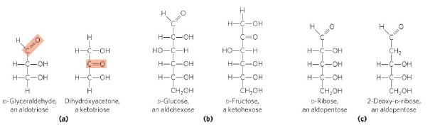
FIGURE 1. Representative monosaccharides. (a) Two trioses, an aldose and a ketose. The carbonyl group in each is shaded. (b) Two common hexoses. (c) The pentose components of nucleic acids. D-Ribose, and 2-deoxy-D-ribose.

Slide 8
Stereoisomerism in sugars
Isomers are molecules that have the same chemical formula and the same bonds, but the configuration of the atoms is different.
When the atoms of a given isomer are kept in the same order but their arrangement in space is different, we call this a stereoisomer.
Sugars exhibit 3 kinds of stereoisomerism:
D- and L- Stereoisomers (Enantiomers)
Epimerism
Anomerism

Slide 9
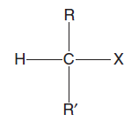
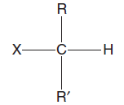
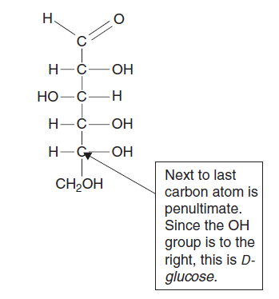
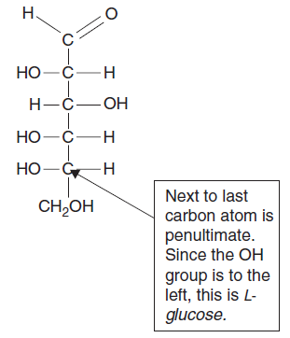
Figure 2. D and L-isomer configurations
Figure 3. An illustration of D- and L-glucose

Slide 10
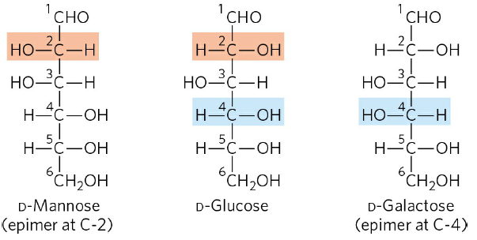
Epimerism
FIGURE 4 Epimers. D-Glucose and two of its epimers are shown as projection formulas. Each epimer differs from D-glucose in the configuration at one chiral center (shaded light red or blue).

Slide 11
Anomerism
Figure 5 To form a pyranose ring from D-glucose, the hydroxyl group on carbon-5 is
added to the carboxyl group at carbon-1.
a
b
Figure 6 The (a) α- and (b) β – isomers of D-glucopuranose.

Slide 12
Sugar Derivatives
Several derivative molecules of carbohydrates exist and can be formed by reduction.
Deoxysugars: one of the hydroxyl groups is replaced by a hydrogen atom (removing one oxygen) e.g. deoxyribose
Sugar alcohols : formed when the carbonyl group is reduced to a hydroxyl group e.g. sorbitol
Sugar amine or Amino sugars: a molecule obtained by substitution of an amine group for a hydroxyl group e.g., glucosamine
Sugar acid : formed when the first carbon or the carbon in the carboxyl group of a monosaccharide is oxidized e.g. gluconic acid
Sugar phosphates: formed by Condensation of phosphoric acid with one of the hydroxyl groups of a sugar to form a phosphate ester e.g. glucose 6-phosphate

Slide 13
Disaccharides
Disaccharides (such as maltose, lactose, and sucrose) consist of two monosaccharides joined covalently by an O-glycosidic bond, which is formed when a hydroxyl group of one sugar molecule, typically in its cyclic form, reacts with the anomeric carbon of the other.
The disaccharide maltose contains two D-glucose residues joined by a glycosidic linkage between C-1 (the anomeric carbon) of one glucose residue and C-4 of the other.
The disaccharide lactose, which yields D-galactose and D-glucose on hydrolysis, occurs naturally in milk.
Sucrose is a disaccharide of glucose and fructose. It is formed by plants but not by animals; the anomeric carbons of both monosaccharide units are involved in the glycosidic bond

Slide 14
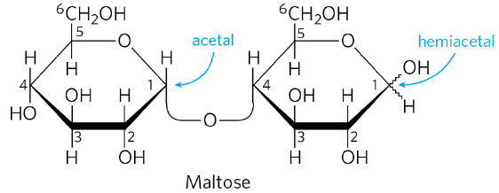
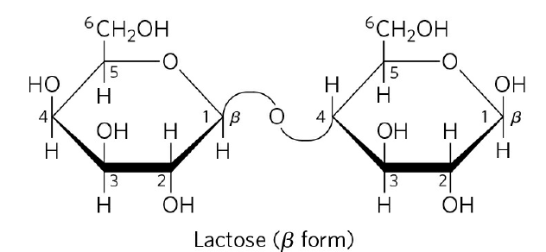
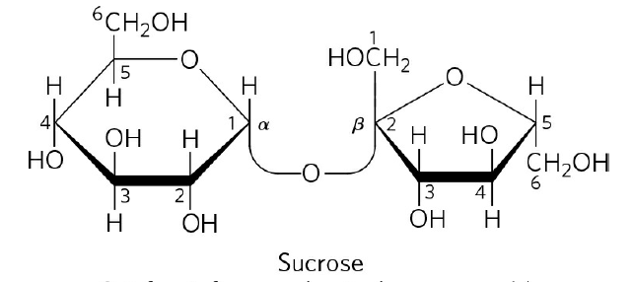
Disaccharides

Slide 15
Polysaccharides
Polysaccharides are compounds containing many sugars linked together into large molecules.
One of the primary functions of polysaccharides is energy storage or food reserve.
Starch, found in plants, is a polymer made up of two more fundamental types of molecules called amylopectin and amylose.
Amylopectin is a branched polymer that consists of glucose units bonded together by α-1,4 linkages. These form chains that are connected to other chains of glucose units bonded together by α -1,4 linkages through an α -1,6 bond (which forms the branching).
Amylopectin is water soluble. It is a very large molecule, and can contain up to 200,000 glucose units. Branching provided by the α -1,6 bond occurs every 24 to 30 glucose units.

Slide 16
Amylose is a linear polymer of glucose units linked together by α-1,4-glycosidic bonds.
It has a simpler structure than amylopectin. The number of glucose units in an amylose molecule can range into the thousands; between 100 and 3000 glucose units.
Despite its simpler structure, amylose is actually harder to digest than amylopectin.
Lower forms of plants contain more amylose because it is easier to store than amylopectin. but Higher plants utilize amylopectin for storage instead.

Slide 17
Cellulose is another major polymer of glucose found in plants, where it is the primary component of cell walls giving plants their structure.
It is a linear polymer of glucose units linked together by β-1,4-glycosidic bonds.
Glycogen is the polysaccharide used for storage in animals. The structure is similar to that of amylopectin, with branches occurring every 8 to 12 glucose units.
Glycogen molecule consists of 60,000 glucose units. It is stored primarily in the liver but can also be found in muscle cells and in small amounts in other types of cells.

Slide 18
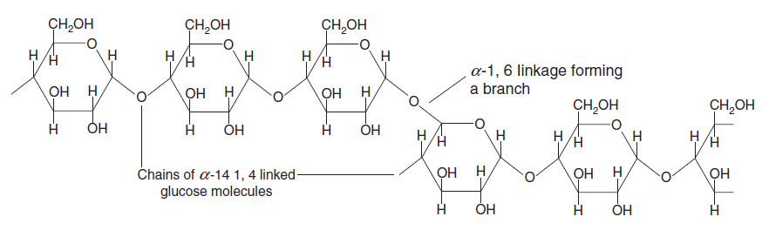
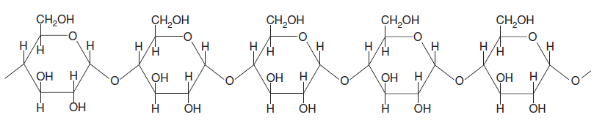
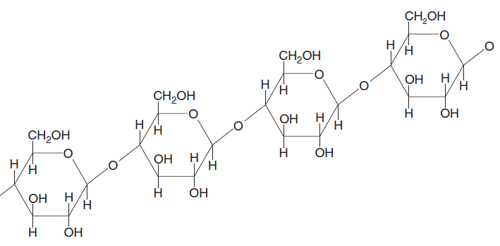
Amylopectin is a branched polymer made up of glucose units.
Amylose is a linear polymer of glucose molecules.
Cellulose is composed of glucose units linked together with β-1,4 bonds.

Slide 19
Assignment
Give 5 examples each of the two series of monosaccharides (ie. Aldoses and pentoses) from carbon 4-7 and draw their structures

Slide 20
Lipids
Lipids are a class of compounds distinguished by their insolubility in water and solubility in nonpolar solvents.
Lipids are important in biological systems because
they form the cell membrane, a mechanical barrier that divides a cell from the external environment.
Lipids also provide energy for life and several essential vitamins are lipids.
Lipids can be divided in two major classes, saponifiable lipids and nonsaponifiablelipids.
Saponifiable lipid contains one or more ester groups allowing it to undergo hydrolysis in the presence of an acid, base, or enzyme. They form soaps on alkaline hydrolysis e.g., triglycerides, glycerophospholipids, sphingolipids
A nonsaponifiable lipid cannot be broken up into smaller molecules by hydrolysis; they do not form soaps e.g., steroids, prostaglandins, and terpenes.

Slide 21
Fatty Acids
A fatty acid is a molecule characterized by the presence of a carboxyl group attached to a long hydrocarbon chain.
These are molecules with a formula R–COOH where R is a hydrocarbon chain. Fatty acids can be said to be carboxylic acids, and come in two major varieties.
Saturated fatty acids: This is a fatty acid that does not have any double bonds. A fatty acid is saturated when every carbon atom in the hydrocarbon chain is bonded to as many hydrogen atoms as possible.
Saturated fatty acids are solids at room temperature.
Animal fats are a source of saturated fatty acids.
Unsaturated fatty acids: An unsaturated fatty acid can have one or more double bonds along its hydrocarbon chain. A fatty acid with one double bond is called monounsaturated. If it contains two or more double bonds, we say that the fatty acid is polyunsaturated.
Fatty acids only contain cis double bonds.
Unsaturated fatty acids are liquids at room temperature.
Plants are the source of unsaturated fatty acids.

Slide 22
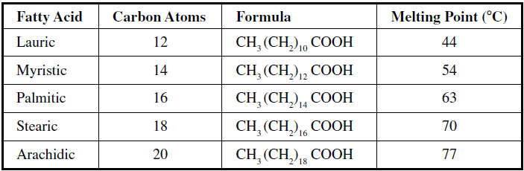
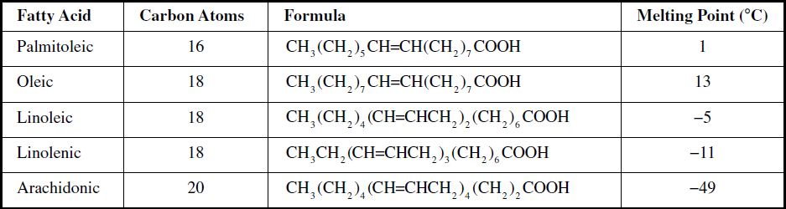
Common Saturated Fatty Acids
Common Unsaturated Fatty Acids

Slide 23
Triglycerides
A triglyceride (often called triacylglycerol) is a fatty acid trimester of glycerol.
Triglycerides are important for human health in that they provide most of the lipids in our diet.
Glycerol has three hydroxyl groups and Fatty acids can be attached at these three sites forming a triglyceride.
One important characteristic of a triacylglycerol is its state at room temperature.
Short-chain unsaturated triglycerides are liquid at room temperature.
Long-chain saturated triglycerides are solid at room temperature.
Animal fats contain a high amount of saturated triglycerides while plant oils contain a high amount of unsaturated triglycerides

Slide 24
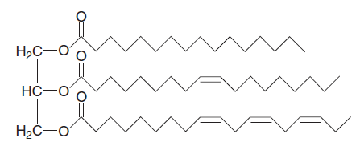
Trigylcerides are formed when each of the OH groups in glycerol reacts with the COOH group of a fatty acid to create an ester group.
Three water molecules are liberated in the process. Note the fatty acid chains which extend from the glycerol backbone.
If all three R groups are the same, that is, the fatty acid that leads to the formation of each ester group in the resulting tryglycerol is the same; we say that the compound is a simple triacylglycerol.
In nature, the R groups will be different. In that case we call the resulting compound a mixed triacylglycerol.
A glycerol molecule.
A triglyceride

Slide 25
Sphingolipids
A sphingolipid is an important constituent of the cell membrane which is based on a backbone molecule called sphingosine rather than glycerol.
Sphingolipids can be found throughout the nervous systems of mammals, where they form a component of the myelin sheath, which is a fatty layer that provides insulation for the axons of neurons.
Components can be incorporated with a sphingosine molecule via reactions at the NH₂ and OH groups.
For example, to obtain a sphingomyelin, a fatty acid is attached at the location of the NH₂ group of sphingosine and a phosphocholine is attached to the OH group.
Another type of sphingolipid called a cerebroside has a saccharide unit attached at the location of the OH group of sphingosine. Cerebrosides are also abundant in the nervous system.
Besides playing a role in the central nervous system, sphingolipids function as cell surface markers, providing ABO blood type antigens.

Slide 26
A sphingolipid consists of a fatty acid bound to sphingosine and an R group.

Slide 27
Steroids
A steroid is a biologically important lipid that cannot be broken down into smaller molecules by the process of hydrolysis because it lacks ester groups.
The defining characteristic of a steroid is the presence of a four-ring system that gives it structure
This ring system contains a single five-membered carbon ring together with three six-membered carbon rings.
A steroid has a four-ring structure.

Slide 28
Cholesterol
The most fundamental and famous steroid is cholesterol. Cholesterol is an important lipid found in the cell membrane.
It is a sterol, which means that cholesterol is a combination of a steroid and an alcohol.
It is an important component of cell membranes and is also the basis for the synthesis of other steroids, including the sex hormones estradiol and testosterone, as well as other steroids such as cortisone and vitamin D.
Cholesterol, which consists of an OH bound to a steroid ring formation and a hydrocarbon chain.

Slide 29
Other steroids that are important in the body include the following:
Androgens These are “male sex hormones” that regulate the development of the male reproductive system and the secondary sexual characteristics in males.
Progesterone, estrone, and estradiol These are “female sex hormones” that regulate the development of the female reproductive system and are responsible for the maintenance of secondary sexual characteristics in females.
Aldosterone This steroid controls water and electrolyte balances.
Cortisone This compound is involved in metabolism and in controlling infl ammation.
Bile salts Facilitates the digestion of certain lipids and the absorption of fat-soluble vitamins.
Vitamin D An important steroid that controls calcium absorption and deposition in the bone. Recent research also suggests that vitamin D plays a fundamental role in the prevention of many cancers. High consumption of vitamin D and sun exposure appear to reduce cancer risk.

Slide 30
Prostaglandins
Terpenes
Prostaglandins are nonsaponifiable lipids that are involved in several body functions.
They consist of a 20-carbon chain that includes a five-membered ring at the end.
One of the most important roles of prostaglandins is in the regulation of blood pressure.
They also control blood clotting and induce labor.
Terpenes are large molecules constructed out of an isoprene, which is a branched carbon-5 unit.
Some biologically important terpenes include:
Vitamin A Important for healthy vision, in particular night vision
Vitamin E An important antioxidant that is involved in the maintenance of cell membrane integrity
Vitamin K Involved in blood clotting

